Slide 1

MODULE 3: PROGRAMMING FOR BIOLOGICAL DATA
Phylogenetics
Multiple Sequence Alignment & Tree Building
Instructor: Dr. Haogao Gu | Date: February 9, 2026

Slide 2








Learning Objectives
Alignment
Distance
Trees
Outbreaks
Perform Multiple Sequence Alignment (MSA) using the msa package.
Calculate genetic distance matrices between sequences.
Build and root Neighbor-Joining trees using ape.
Interpret phylogenetic clusters for outbreak investigation.

Slide 3

Part 1: Multiple Sequence Alignment
Finding Homology in Chaos

Slide 4

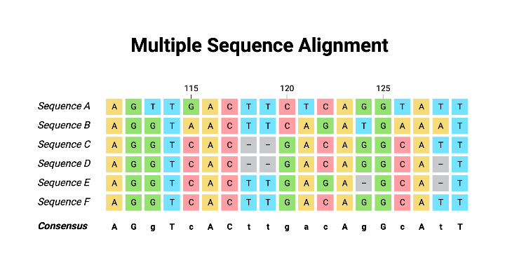
What is MSA?
Definition
Multiple Sequence Alignment (MSA) is the process of arranging three or more sequences to identify homologous regions.
Mechanism
Algorithms insert gaps (-) to shift sequences so that similar bases align vertically, maximizing the overall similarity score.

Slide 5
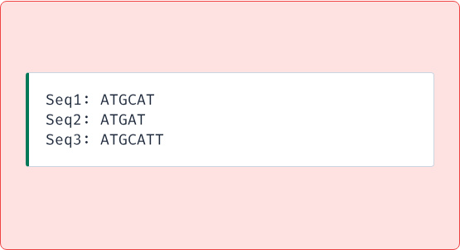
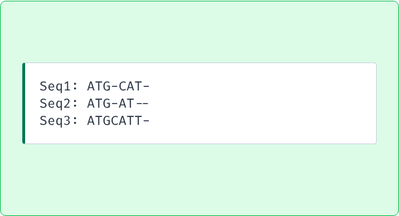
Why Do We Align?
Alignment is the only way to accurately compare sequences of different lengths or with insertions/deletions.
Raw (Unaligned)
Aligned
Hard to compare positions.
Reveals mutations and gaps.

Slide 6
Popular Alignment Algorithms
Algorithm | Speed | Accuracy | Use Case
ClustalW | Slow | Good | Small datasets, classic method.
MUSCLE | Fast | Very Good | Medium datasets, general purpose.
MAFFT | Very Fast | Excellent | Large datasets (e.g., viral genomes).

Slide 7
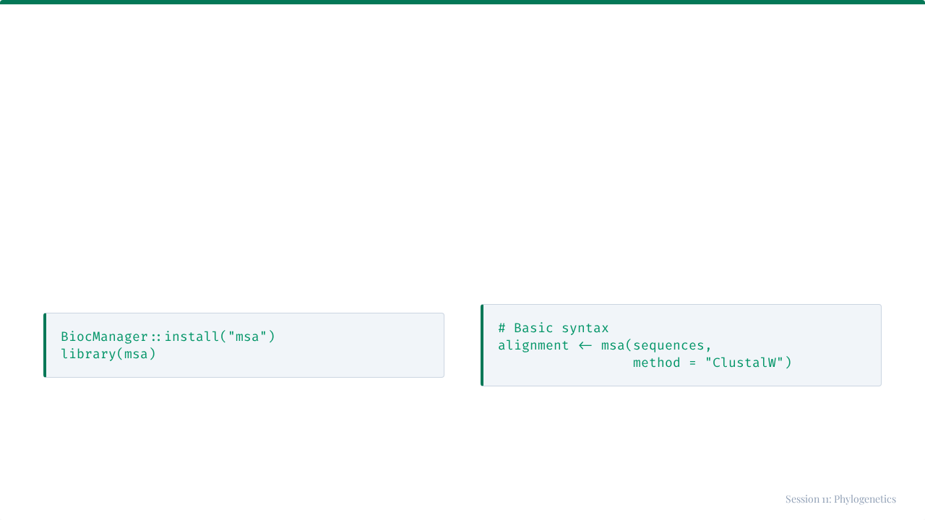
The msa Package
A unified R interface for ClustalW, ClustalOmega, and MUSCLE.
Installation
Basic Usage

Slide 8
Loading Sequences
library(Biostrings) # Option 1: Read from File seqs <- readDNAStringSet("virus_seqs.fasta") # Option 2: Create manually seqs <- DNAStringSet(c( "Sample1" = "ATGCATGC", "Sample2" = "ATGGATGC" ))

Slide 9
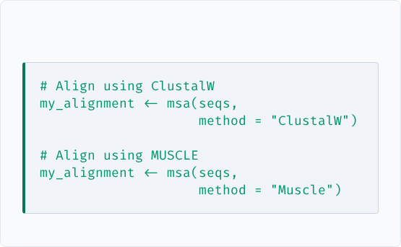

Performing the Alignment
Running the function
Output Object
Returns an MsaDNAMultipleAlignment object containing the aligned sequences (with gaps).

Slide 10
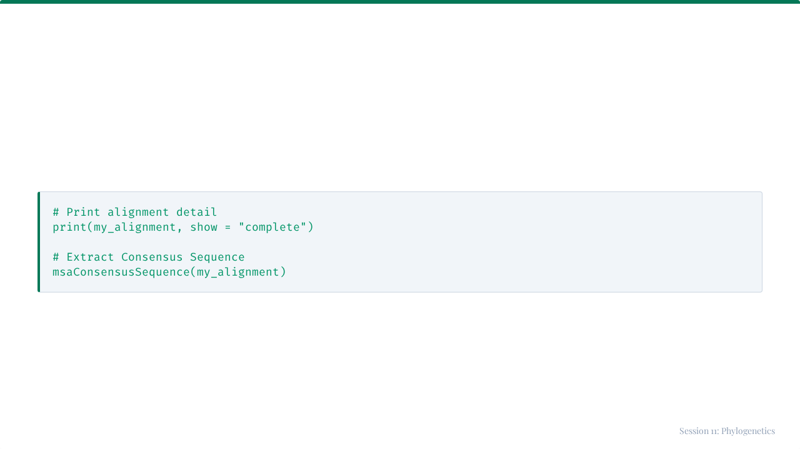
Viewing Results
The print output shows sequences stacked on top of each other, making mismatches visible.

Slide 11
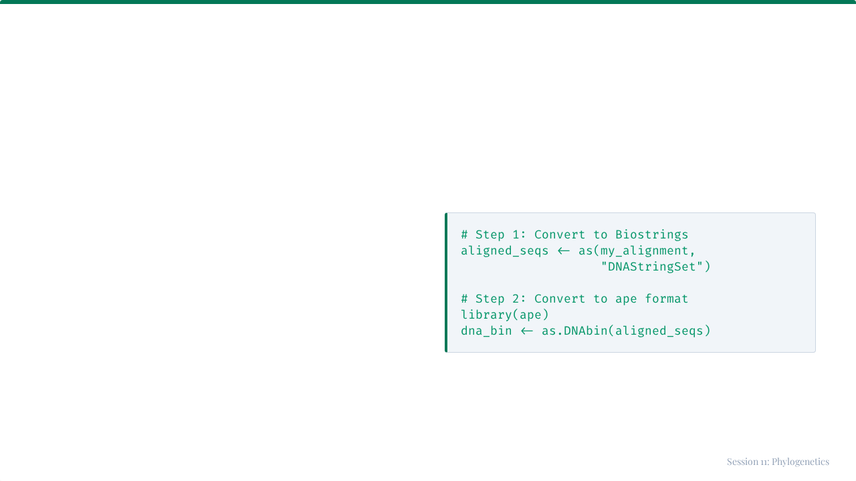
Converting for Tree Building
The msa package produces its own object type.
To build trees with the ape package, we must convert it to DNAbin format.

Slide 12

Part 2: Phylogenetic Trees
Visualizing Evolutionary Relationships

Slide 13



What is a Phylogenetic Tree?
A branching diagram showing the inferred evolutionary relationships among various biological species or entities.
Tips
Nodes
Branches
The sequences/samples (Leaves).
Common ancestors (divergence points).
Length often represents genetic change.

Slide 14
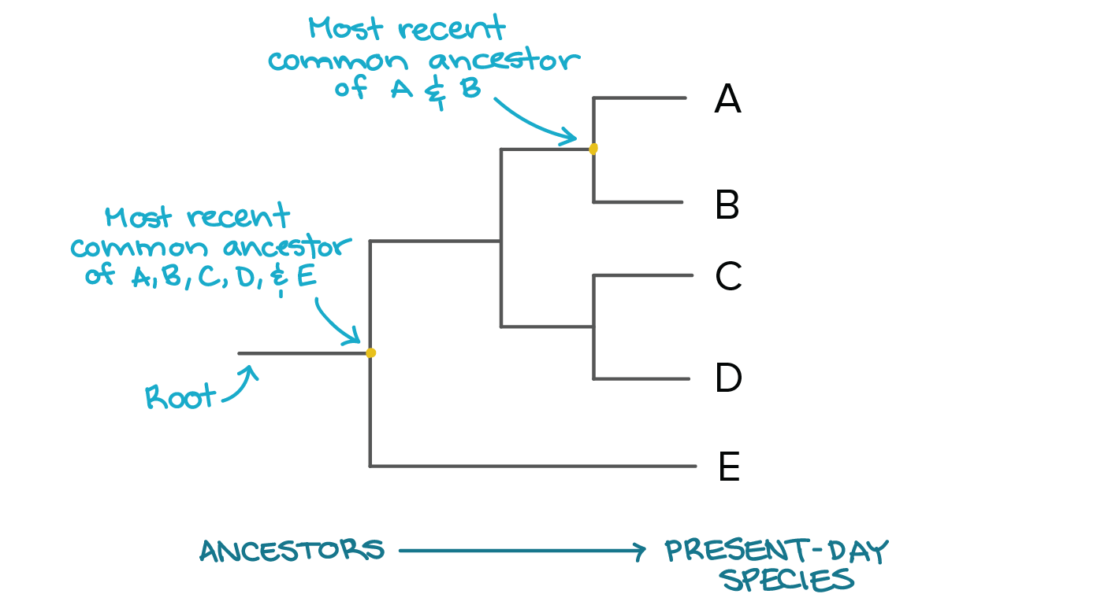

Anatomy of a Tree

Slide 15


Genetic Distance
Concept
p-distance
Before building a tree, we must quantify "how different" every pair of sequences is.
The simplest measure: Proportion of sites that differ.
Distance = Differences / Total Sites
Example: 2 diffs in 10 sites = 0.20

Slide 16
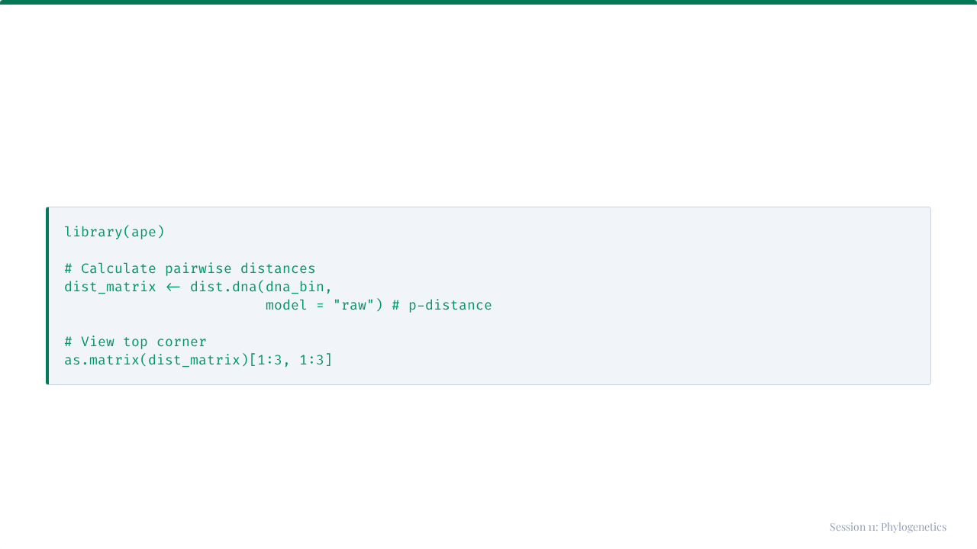
Calculating Distance Matrix
The output is a symmetric matrix where every cell [i, j] is the distance between sequence i and j.

Slide 17
Evolutionary Models
Evolution isn't always simple. Different models correct for hidden changes.
Model | Description
raw | Simple p-distance (observed differences).
JC69 | Jukes-Cantor. Assumes equal mutation rates.
K80 | Kimura 2-parameter. Distinguishes Transitions vs Transversions.
TN93 | Tamura-Nei. More realistic for viral evolution.

Slide 18



Tree Building Methods
Neighbor-Joining (NJ)
UPGMA
Maximum Likelihood
Fast. Distance-based. Good for large initial datasets.
Very Fast. Assumes constant molecular clock (often unrealistic).
Slow. Statistical model-based. Most accurate standard method.

Slide 19
Neighbor-Joining Algorithm
1.
Start with a star-like tree (all tips connected to center).
2.
Find the pair of taxa with the shortest distance.
3.
Join them into a new node (neighbors).
4.
Calculate distance from new node to everything else.
5.
Repeat until all taxa are joined.
Result: An unrooted tree with branch lengths proportional to change.

Slide 20
Building the Tree in R
# 1. Calculate distance dist_mat <- dist.dna(dna_bin, model = "raw") # 2. Build tree tree <- nj(dist_mat) # 3. Basic Plot plot(tree)

Slide 21
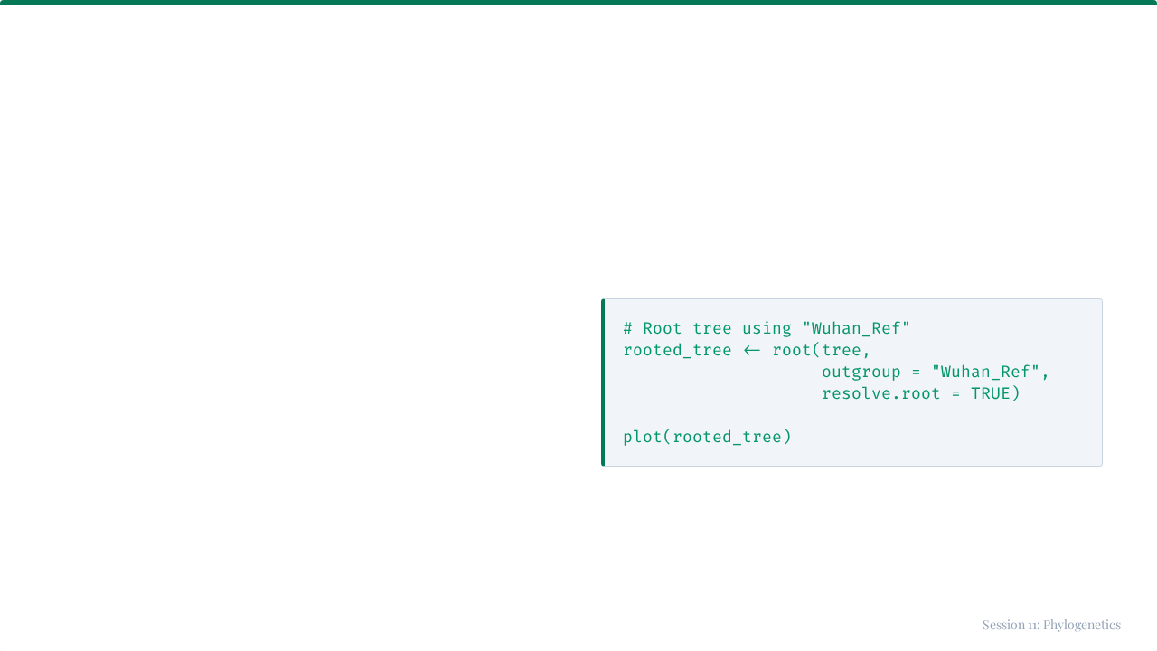
Rooting the Tree
Why Root?
NJ trees are unrooted (no time direction). We use an Outgroup (a known distant relative) to define the root.

Slide 22
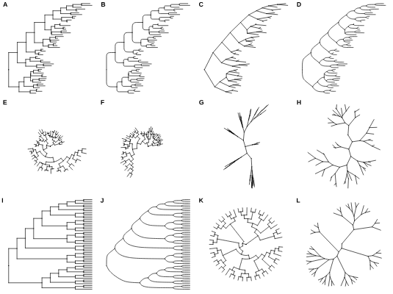
Tree Layouts
Trees can be visualized in many ways to highlight different aspects.
•
Phylogram: Branch lengths = distance.
•
Cladogram: Only shows branching order.
•
Fan/Radial: Good for large trees.

Slide 23


Clinical Application: Outbreaks
The Question
The Logic
Are these patients part of the same transmission chain?
If patient sequences cluster together on the tree (monophyletic group) with very short branch lengths, they are likely epidemiologically linked.

Slide 24
Example: HK vs SZ Outbreak
Imagine we have patients from Hong Kong (HK) and Shenzhen (SZ).
We sequence them and build a tree with reference variants (Delta, Omicron).
•
If HK patients group with Omicron...
•
And SZ patients group with Delta...
•
Conclusion: Two independent outbreaks caused by different variants.

Slide 25
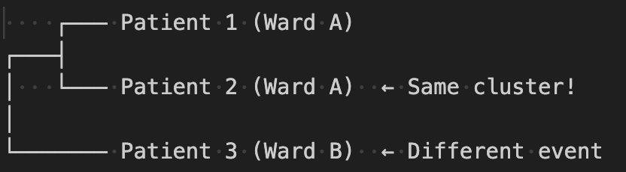
Interpreting Clusters
Patients 1 & 2 are linked. Patients 3 is unrelated.

Slide 26
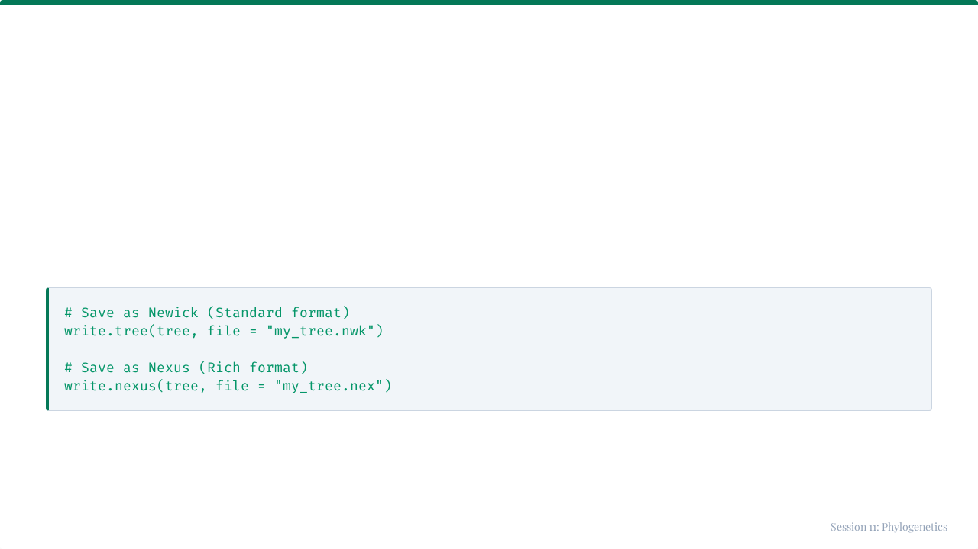
Saving Your Tree
You can save trees to open in other software (FigTree, Dendroscope).

Slide 27
Complete Workflow
# 1. Load Sequences seqs <- readDNAStringSet("data.fasta") # 2. Align aln <- msa(seqs) # 3. Convert & Distance bin <- as.DNAbin(as(aln, "DNAStringSet")) dist <- dist.dna(bin) # 4. Build & Plot tree <- nj(dist) plot(tree)

Slide 28
Key Takeaways
•
MSA is the foundation of phylogenetics; it identifies homologous sites.
•
Genetic Distance matrices quantify sequence differences.
•
Neighbor-Joining (NJ) is a fast, reliable method for initial tree building.
•
Clustering on a tree indicates evolutionary relatedness.
•
This workflow allows us to trace pathogen transmission paths.

Slide 29

Tutorial 11
Constructing the Tree
Open your R environment

Slide 30
Tutorial 11: Constructing the Tree
Building a Phylogenetic Tree from Outbreak Sequences

Slide 31
Your Scenario
The Task
You are investigating a SARS-CoV-2 outbreak.
Data:
•
4 Reference Variants (Wuhan, Alpha, Delta, Omicron).
•
5 Patient Samples (HK and SZ).
Goal: Assign patients to variants.

Slide 32




The Workflow
1
2
3
4
Align
Convert
Distance
Tree
msa()
DNAbin
dist.dna()
nj()

Slide 33
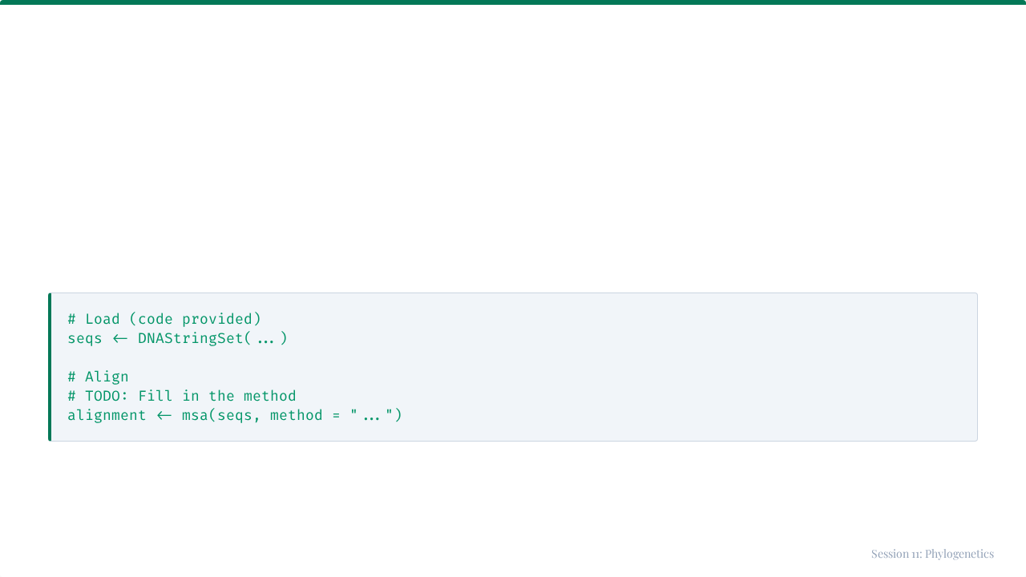
Steps 1 & 2: Load and Align
First, we create the dataset and align it.

Slide 34
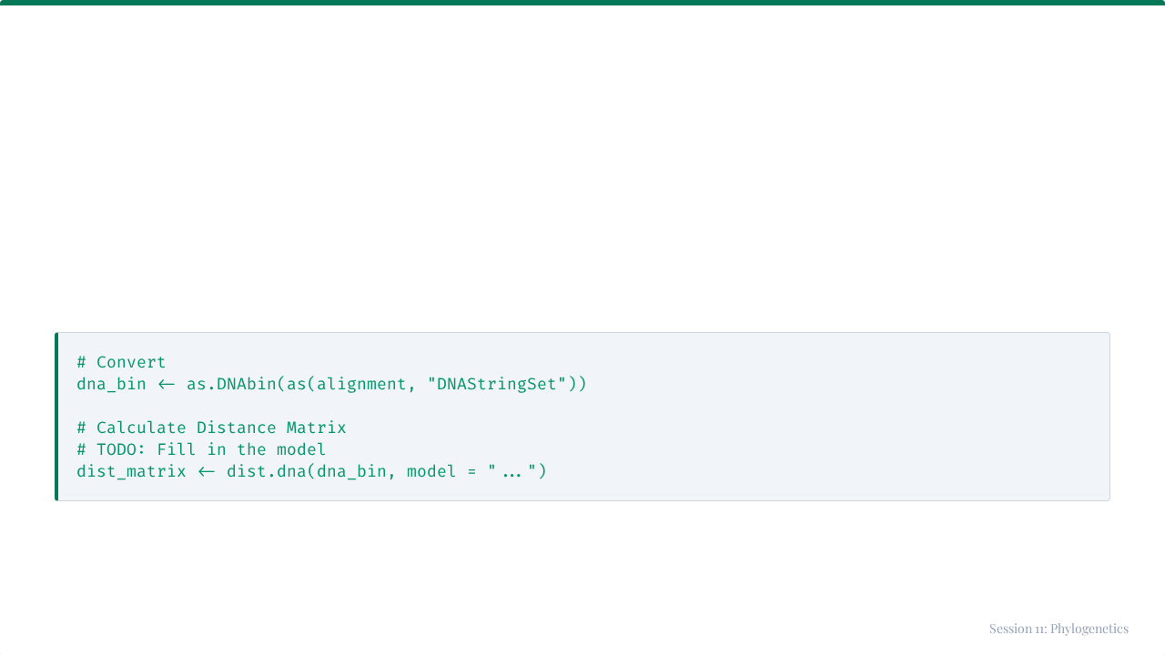
Steps 3 & 4: Convert and Distance
Prepare the data for the ape package.

Slide 35
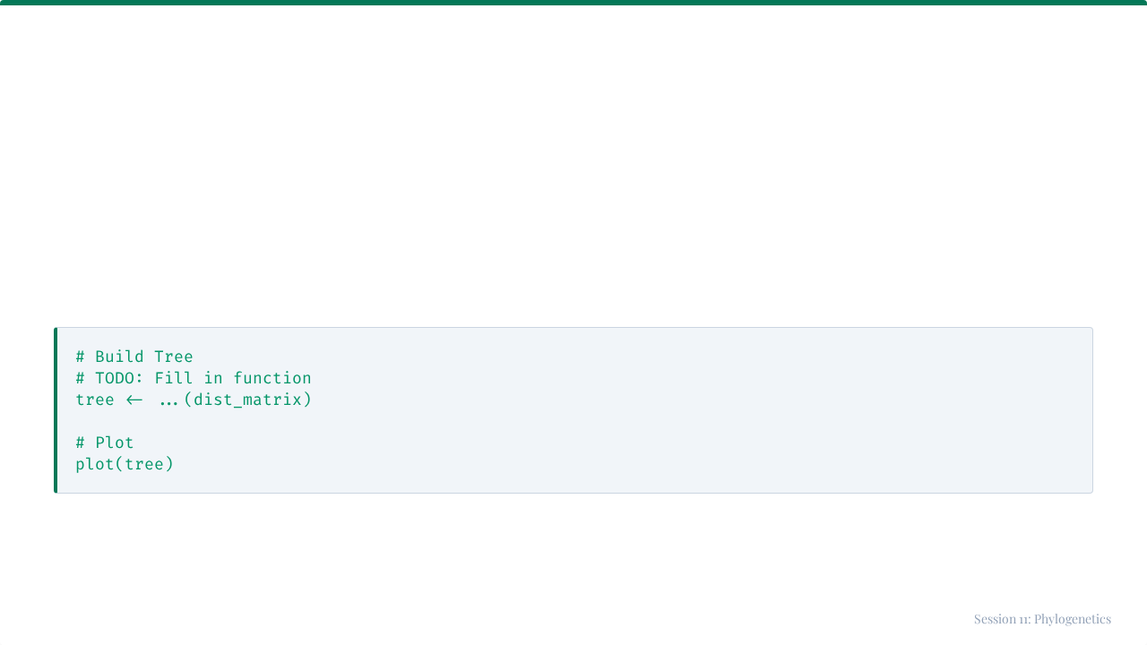
Step 5: Build Tree
Construct the Neighbor-Joining tree.

Slide 36
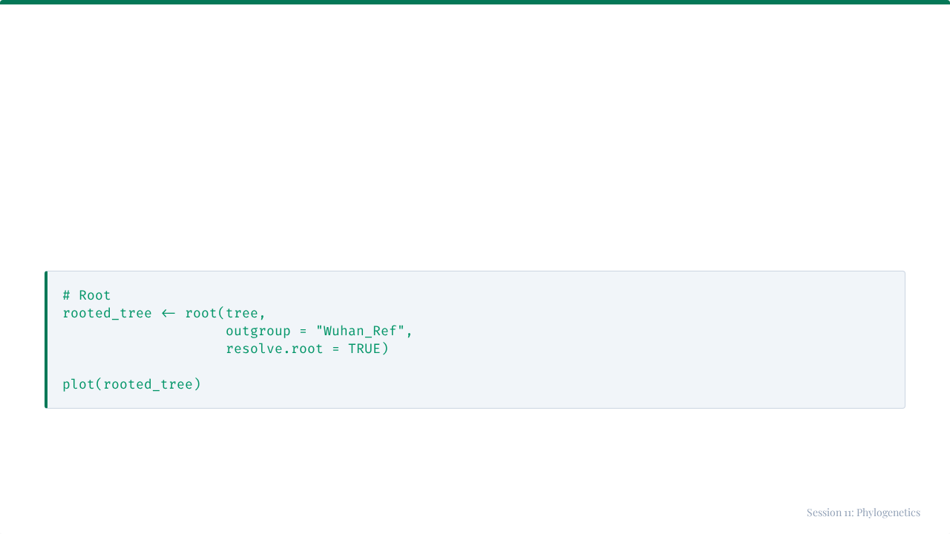
Step 6: Rooting
Root the tree using the ancestral strain.

Slide 37
Expected Outcome
Look for Clusters
Conclusion
•
HK Patients (1,2,3): Should cluster with Omicron.
This suggests two separate introduction events, rather than a single cross-border transmission chain.
•
SZ Patients (4,5): Should cluster with Delta.

Slide 38

Session 11 Complete
You can now build phylogenetic trees in R!

